Slide 1


Mastering NumPy: From Basics to Expert Level
Numerical Computing with Python

Slide 2

Training Objectives & Outcomes
1
Understand the fundamentals of NumPy arrays
2
Perform efficient mathematical and statistical operations
3
Master advanced techniques like broadcasting, indexing, and memory handling
4
Apply NumPy to real-world ML, data science, and scientific problems
Instructor : Fawad Bahadur

Slide 3



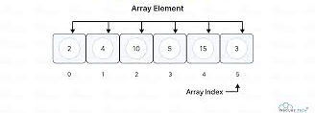
Introduction to NumPy
Definition
NumPy (Numerical Python) is the foundational library for numerical computing in Python.
Provides the powerful ndarray object for multi-dimensional arrays.
Why Use NumPy?
Fast: Written in C, supports vectorized operations
Efficient: Less memory than Python lists
Versatile: Used in ML, data science, image processing, simulations
Example
import numpy as np
arr = np.array([1, 2, 3])
print(arr * 2) # Output: [2 4 6]
Key Features
N-dimensional arrays
Broadcasting
Mathematical and logical operations
Linear algebra & random number generation
Integration with other libraries (Pandas, TensorFlow, Scikit-learn)
Instructor : Fawad Bahadur

Slide 4
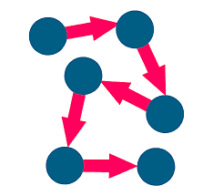



Creating Arrays in NumPy
1. Using np.array()
import numpy as np
a = np.array([1, 2, 3]) # 1D
b = np.array([[1, 2], [3, 4]]) # 2D
3. Generating Sequences
np.arange(0, 10, 2) # [0, 2, 4, 6, 8]
np.linspace(0, 1, 5) # [0. , 0.25, ..., 1.]
2. Predefined Functions
np.zeros((2, 3)) # Array of zeros
np.ones((2, 3)) # Array of ones
np.full((2, 2), 7) # Array filled with 7
np.eye(3) # Identity matrix
4. Random Arrays
np.random.rand(2, 3)
# Uniform [0,1)
np.random.randint(0, 10, 5)
# Random integers
Note
Use .dtype to control data type if needed.
Instructor : Fawad Bahadur

Slide 5
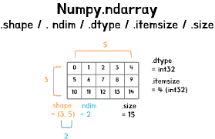
Understanding NumPy Array Attributes
1. Key Attributes of ndarray
import numpy as np
arr = np.array([[1, 2, 3], [4, 5, 6]])
2. Common Attributes
arr.shape → (2, 3): Dimensions (rows, columns)
arr.ndim → 2: Number of dimensions
arr.size → 6: Total number of elements
arr.dtype → int64: Data type of elements
arr.itemsize → 8: Bytes per element
arr.nbytes → 48: Total memory (size × itemsize)
3. View in Practice
print(arr.shape, arr.ndim, arr.dtype)
Tip
Understanding these helps in debugging, optimization & reshaping operations.
Instructor : Fawad Bahadur

Slide 6
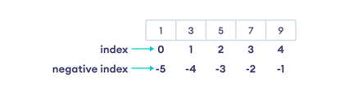
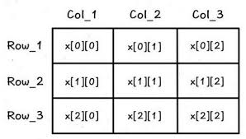
Indexing & Slicing in NumPy Arrays
Basic Indexing
arr = np.array([[10, 20, 30], [40, 50, 60]])
arr[0, 1] # Output: 20
arr[1][2] # Output: 60
2. Slicing Syntax
array[start:stop:step]
arr[0, :2] # First row, first two columns → [10 20]
arr[:, 1:] # All rows, columns from index 1 → [[20 30], [50 60]]
3. Negative Indexing
arr[-1, -2] # Second last element in last row → 50
4. 1D vs 2D Behavior
a = np.arange(10)
a[2:7:2] # Output: [2 4 6]
Tip
Use slicing to avoid loops and write efficient code.
Instructor : Fawad Bahadur

Slide 7
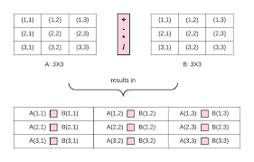
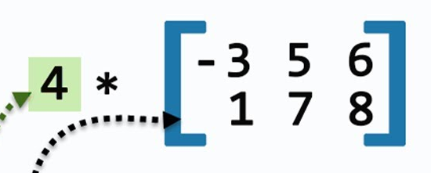
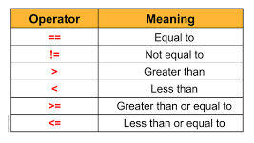
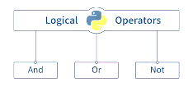
Arithmetic & Logical Operations in NumPy
Element-wise Arithmetic
a = np.array([1, 2, 3])
b = np.array([4, 5, 6])
a + b # [5 7 9]
a * b # [4 10 18]
a / b # [0.25 0.4 0.5]
2. Scalar Operations
a * 10 # [10 20 30]
a 1 # [0 1 2]
3. Comparison Operators
a > 2 # [False False True]
b == 5 # [False True False]
4. Logical Operations
np.logical_and(a > 1, b < 6) # [False True False]
Note
All operations are vectorized — no explicit loops needed.
Instructor : Fawad Bahadur

Slide 8
Universal Functions in NumPy
1. What Are ufuncs?
Functions that operate element-wise on arrays.
Highly optimized, fast, and support broadcasting.
4. Aggregation Functions
np.sum(a) # 6
np.mean(a) # 2.0
np.max(a) # 3
2. Math Functions
a = np.array([1, 2, 3])
np.sqrt(a) # [1. 1.414213 1.732050]
np.exp(a) # [ 2.718 7.389052 20.085536]
np.log(a) # [0. 0.693141 1.09862]
5. Apply ufuncs to Multi-Dim Arrays
b = np.array([[1, 2], [3, 4]])
np.sum(b, axis=0) # Column-wise sum: [4 6]
Function | Description
np.add | Element-wise addition
np.subtract | Element-wise subtraction
np.multiply | Element-wise multiplication
np.divide | Element-wise division
Bool | Boolean True/False
np.exp | exponential functions
3. Trigonometric Functions
np.sin(np.pi / 2) # 1.0
np.cos(0) # 1.0
Tip
ufuncs are faster and more memory-efficient than loops.
Instructor : Fawad Bahadur

Slide 9
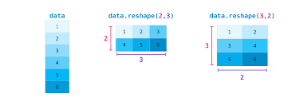
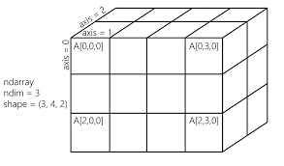
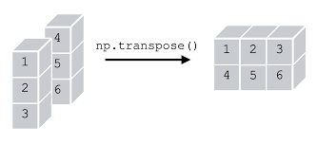

Reshaping & Manipulating Array Shapes
🔹 Reshape Arrays
arr = np.arange(6)
reshaped_arr = arr.reshape(3, 2)
🔹 Flatten Arrays
b.flatten() # [0 1 2 3 4 5]
[[1,2,3], [4,5,6]]
Flatten
[1,2,3,4,5,6]
🔹 Add/Remove Dimensions
a = np.array([1, 2, 3])
a[np.newaxis, :] # Shape: (1, 3)
a[:, np.newaxis] # Shape: (3, 1)
🔹 Transpose Arrays
b = np.array([[1, 2], [3, 4]])
b.T # [[1 3] # [2 4]]
Note
Always ensure compatibility before reshaping to avoid errors.
Instructor : Fawad Bahadur

Slide 10
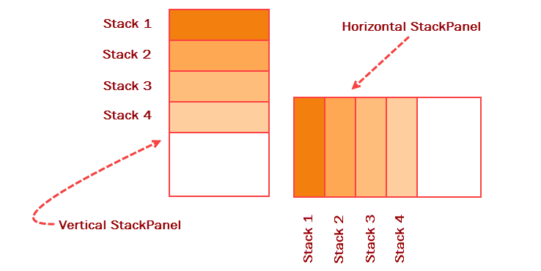
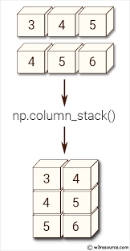
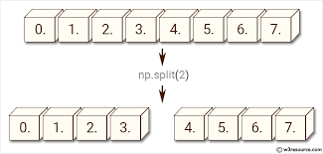
Stacking & Splitting Arrays in NumPy
1. Vertical & Horizontal Stacking
a = np.array([1, 2])
b = np.array([3, 4])
np.vstack((a, b)) # [[1 2] # [3 4]]
np.hstack((a, b)) # [1 2 3 4]
2. Column & Row Stack (2D only)
a = np.array([[1], [2]])
b = np.array([[3], [4]])
np.column_stack((a, b)) # [[1 3] # [2 4]]
np.row_stack((a.T, b.T)) # [[1 2] # [3 4]]
3. Splitting Arrays
x = np.array([[1, 2, 3], [4, 5, 6]])
np.hsplit(x, 3) # Split into 3 columns
np.vsplit(x, 2) # Split into 2 rows
Note
Ensure dimensions match for stacking/splitting.
Instructor : Fawad Bahadur

Slide 11
Understanding NumPy Data Types
What is dtype?
Specifies the type of elements in an array
Controls memory size and operations behavior
dtype | Description
Int32 | 32-bit integer
Int64 | 64-bit integer
Float32 | 32-bit floating point
Float64 | 64-bit floating point
Bool | Boolean True/False
Complex | Complex numbers
Specifying dtype
a = np.array([1, 2, 3], dtype=np.float32)
print(a.dtype) # float32
Converting dtypes
b = a.astype(np.int64)
print(b.dtype) # int64
Note
Choosing correct dtype improves performance and saves memory.
Instructor : Fawad Bahadur

Slide 12
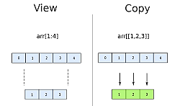
Copy vs View in NumPy Arrays
What is a View?
A view is a new array object that looks at the same data.
Changes in view affect the original array.
a = np.array([1, 2, 3])
v = a.view()
v[0] = 10
print(a) # [10 2 3]
What is a Copy?
A copy creates a new independent array.
Changes in copy don’t affect the original.
c = a.copy()
c[0] = 20
print(a) # [10 2 3]
print(c) # [20 2 3]
When to Use?
Use view to save memory (if you want linked changes)
Use copy to avoid unintentional changes
Instructor : Fawad Bahadur

Slide 13
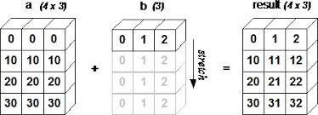
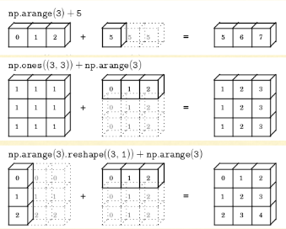
Broadcasting in NumPy
What is Broadcasting?
Broadcasting enables operations between:
Arrays of different sizes
Arrays with different dimensions
A scalar and an array
Rules of Broadcasting
If arrays differ in dimensions, prepend 1s to smaller array’s shape.
Arrays are compatible if dimensions are equal or one of them is 1.
Broadcasting happens to match shapes.
a = np.array([[1, 2, 3], [4, 5, 6]]) # Shape (2,3)
b = np.array([10, 20, 30]) # Shape (3,)
print(a + b) # Output:[[11 22 33][14 25 36]]
Broadcasting with Scalars
a = np.array([1, 2, 3])
print(a * 2) # [2 4 6]
Tip
Broadcasting helps avoid explicit loops, improving speed and code clarity.
Instructor : Fawad Bahadur

Slide 14
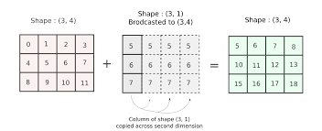
Conti…
Example 1
a = np.ones((3, 4))
b = np.arange(4)
print((a + b).shape) # (3, 4)
Example 2
a = np.ones((5, 1, 4))
b = np.ones((1, 3, 1))
print((a + b).shape) # (5, 3, 4)
Incompatible Shapes
a = np.ones((2, 3))
b = np.ones((3, 2))
a + b # Raises ValueError
Tip
Use broadcasting to write efficient vectorized code without loops.
Instructor : Fawad Bahadur

Slide 15
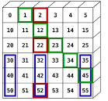
Fancy Indexing in NumPy
What is Fancy Indexing?
Indexing arrays using integer arrays or lists.
Allows selecting multiple arbitrary elements.
Example with 1D Array
a = np.array([10, 20, 30, 40, 50])
indices = [1, 3, 4]
print(a[indices]) # Output: [20 40 50]
Example with 2D Array
b = np.array([[1, 2], [3, 4], [5, 6]])
rows = [0, 1]cols = [1, 0]
print(b[rows, cols]) # Output: [2 3]
Tip
Fancy indexing returns a copy, not a view.
Instructor : Fawad Bahadur

Slide 16
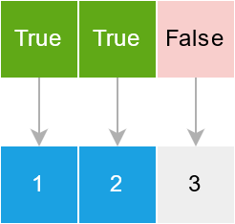
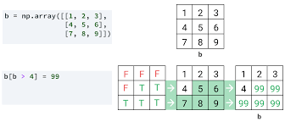
Boolean Indexing in NumPy
What is Boolean Indexing?
What is Boolean Indexing?
Select elements based on conditions.
Returns elements where the condition is True.
a = np.array([10, 20, 30, 40, 50])
mask = a > 25
print(a[mask]) # Output: [30 40 50]
Combining Conditions
print(a[(a > 15) & (a < 45)]) # Output: [20 30 40]
print(a[(a < 15) | (a > 45)]) # Output: [10 50]
Modify Elements Using Boolean Indexing
a[a < 30] = 0print(a) # Output: [ 0 0 30 40 50]
Tip
Boolean indexing is a powerful tool for filtering and updating arrays efficiently.
Instructor : Fawad Bahadur

Slide 17
Random Number Generation with NumPy
Why Use NumPy Random?
Generate random numbers for simulations, ML, testing.
Supports various distributions.
Common Functions
Function | Description | Example
np.random.rand(d0, d1) | Uniform distribution [0,1) | np.random.rand(2,3)
np.random.randn(d0, d1) | Standard normal distribution (mean=0, std=1) | np.random.randn(3)
np.random.randint(low, high, size) | Random integers between low (inclusive) and high (exclusive) | np.random.randint(0, 10, 5)
np.random.choice(array, size) | Random sample from array | np.random.choice([1,2,3], 2)
Tip
Use np.random.seed() to get consistent results.
Instructor : Fawad Bahadur

Slide 18
Aggregation Functions in NumPy
What are Aggregation Functions?
Perform computations over array elements to produce single or reduced values.
Common Aggregations
Function | Description
np.sum() | Sum of all elements
np.mean() | Arithmetic mean
np.median() | Median value
np.min() | Minimum value
np.max() | Maximum value
np.std() | Standard deviation
np.var() | Variance
Example
a = np.array([[1, 2], [3, 4]])
print(np.sum(a)) # 10
print(np.mean(a)) # 2.5
print(np.min(a)) # 1
print(np.max(a, axis=0)) # [3 4] (max of columns)
Tip
Use axis parameter to aggregate along rows or columns.
Instructor : Fawad Bahadur

Slide 19
Linear Algebra Operations in NumPy
What are Aggregation Functions?
Perform computations over array elements to produce single or reduced values.
Common Aggregations
Function | Description
np.dot(a, b) | Dot product of two arrays
np.matmul(a, b) | Matrix multiplication
np.transpose(a) | Transpose of a matrix
np.linalg.inv(a) | Inverse of a square matrix
np.linalg.det(a) | Determinant of a square matrix
np.linalg.eig(a) | Eigenvalues and eigenvectors
np.linalg.norm(a) | Vector or matrix norm
Example
a = np.array([[1, 2], [3, 4]])
b = np.array([[5, 6], [7, 8]])
print(np.dot(a, b)) #[[19 22][43 50]]
print(np.linalg.inv(a))
Tip
For solving linear systems, use np.linalg.solve(A, b)..
Instructor : Fawad Bahadur

Slide 20
Advanced Indexing in NumPy
Combining Indexing Types
Mix of integer, slice, and boolean indexing
a = np.arange(20).reshape(4,5)
print(a[1:3, [0, 2, 4]]) #Select rows 1-2, columns 0,2,4
Using np.ix_ for Cross-Indexing
rows = [0, 2]
cols = [1, 3]
print(a[np.ix_(rows, cols)]) # Select rows 0 & 2 and cols 1 & 3
Ellipsis (...)
Represents “all preceding/succeeding dimensions”
print(a[..., 2]) #All rows, column 2
Tip
Advanced indexing returns copies, use carefully for large arrays.
Instructor : Fawad Bahadur

Slide 21
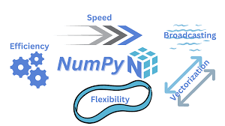


Vectorization in NumPy
What is Vectorization?
Vectorization means using NumPy operations to replace explicit loops with array-level operations. It leads to cleaner code and massive speed improvements.
Example
Loop
a = [1, 2, 3, 4]
b = [x**2 for x in a]
Vectorized
import numpy as np
a = np.array([1, 2, 3, 4])
b = a ** 2 # Vectorized
Performance Comparison
%timeit [x**2 for x in range(100000)] # Slower
%timeit np.arange(100000) ** 2 # Faster
Pro Tip
Use np.where(), np.sum(), np.dot(), and logical ops to replace loops wherever possible.
Instructor : Fawad Bahadur

Slide 22

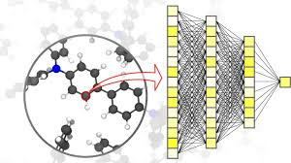


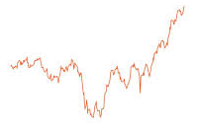
NumPy in Real-World Applications
Machine Learning & AI
Data preprocessing (normalization, scaling)
Vectorized loss functions and activations
Feeding NumPy arrays into ML models (Scikit-learn, TensorFlow)
4. Scientific Simulations
Physics/chemistry simulations
Matrix-heavy modeling with real-time data
2. Image Processing
Images as NumPy arrays (Height × Width × Channels)
Operations: cropping, resizing, filtering
from PIL import Imageimg = np.array(Image.open("image.jpg"))
5. Finance & Data Analytics
Portfolio simulations
Risk modeling using random sampling
Fast computations on large datasets
3. Time Series Analysis
Slicing and rolling window operations
Computing moving averages, FFT, etc.
6. Backend for Pandas & Other Libraries
Pandas DataFrames use NumPy internally
TensorFlow/PyTorch accept NumPy arrays as input
Instructor : Fawad Bahadur

Slide 23
NumPy vs Alternative Libraries
Feature | NumPy | Pandas | TensorFlow NumPy / PyTorch
Primary Use | Numerical arrays | Data analysis (tables) | ML & deep learning tensors
Data Structures | Ndarray | DataFrame, Series | Tensors
Ease of Use | Low-level, flexible | High-level, tabular | ML-focused, GPU-enabled
Performance | CPU optimized | Built on NumPy | GPU & TPU acceleration
Broadcasting Support | Yes | Limited | Yes
GPU Support | No | No | Yes
Autograd (Gradient) | No | No | Yes
Ecosystem Integration | Core scientific Python | Data science | Deep learning
When to Use
Use NumPy for raw numerical computations and scientific work.
Use Pandas for data manipulation and analysis.
Use TensorFlow/PyTorch when building/train deep learning models.
Instructor : Fawad Bahadur

Slide 24
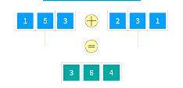



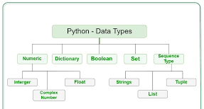
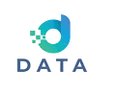


Best Practices for Efficient NumPy Coding
1. Use Vectorized Operations
Always Avoid explicit Python loops; leverage NumPy’s fast array computations.
5. Use Broadcasting Wisely
Understand broadcasting rules to
avoid unexpected bugs or performance issues.
2. Prefer Views Over Copies
Use slicing and .view() to save memory and improve speed.
6. Document Complex Operations
Write comments or use helper functions
to keep code readable.
3. Choose Appropriate dtypes
Use smaller types (float32, int8) if precision allows, to save memory.
7. Test with Realistic Data Sizes
Check performance and memory on
data similar to your production workloads.
4. Avoid Growing Arrays in Loops
Preallocate arrays with np.empty() or np.zeros() when possible.
8. Keep NumPy Updated
Use the latest stable version to benefit
from performance improvements.
Instructor : Fawad Bahadur

Slide 25
THANK YOU
Instructor : Fawad Bahadur

